Slide 1
Cyber Crime investigations
Class 2: What is forensics and why it matters?
Prof. Shumba
January 9,2019
© Copyright 2014: Jenny A. Applequist. All Rights Reserved.

Slide 2
Outline
What is digital forensics and why it matters?
Crime in the digital age
The role of an investigator
The forensic science paradigm video – Mark Pollitt

Slide 3
NIST definition
The application of science to
the identification,
collection,
examination and analysis of data
while preserving the integrity of the information and maintaining a strict chain of custody for the data

Slide 4
Digital Forensics (FBI website)
Seize
Preserve
Process
Forensically Examine
Present in Court of Law

Slide 5
Types of Forensics Analysis
Disk
Email
Network
Internet
Software
Live System

Slide 6
Beyond Computers
Mobile Phones
FAX Machine
Network Components
Routers
Firewalls
Cameras
Output Devices
Copiers
Printers
Servers
Portable Devices
Other
Gaming Consoles

Slide 7
Digital forensics
Standard forensic definitions:
Cover murder cases, requiring special tools for analyzing fingerprints, blood stains, and other expertise.
Digital :
Limits our focus to technology-based crime -a newer form of forensics
Demand is increasing – Why?
Why are attackers using technology more?

Slide 8
Why are attackers using technology more?
Less exposure committing a crime from a computer.
More targets are available online
Global reachability -any organization with network connectivity is a target, regardless of law or location.
Criminals will follow the money
Waiving my iWatch over the scanner -coffee

Slide 9
Why forensics matters?
“….the world is bad, you need forensics to identify when bad stuff happens”
Is this enough?
Shodan (www.shodan.io/)
Search engine for systems are easy to hack, eg SCADA systems.
Can access innumerable web-enabled servers, network devices, home security systems

Slide 10
Discussion one
Smart chips and PINS – what are we doing wrong?
Internet is a % of what is available online. Why?
How is the IoT, IOE,M2M changing the face of digital crime?

Slide 11
Crime in the digital age
Smart chips and PINS – what are we doing wrong?
Sales cycle vulnerability
No security operations center
Small businesses -adversary target
How about the e-Bay-like market for stolen data?
Internet is a % of what is available online.

Slide 12
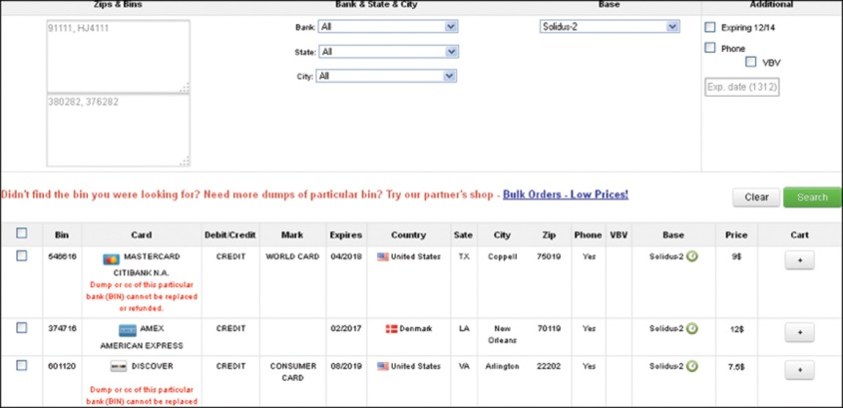
With privacy available

Slide 13
Crime in the digital age
The surface web - web based content that can be found in search engines.
The deep web is everything else.
The Darknet:
Networks not found with search engines that can only be accessed
Tor network
Users are anonymous, random onion address, web service owners - anonymous

Slide 14
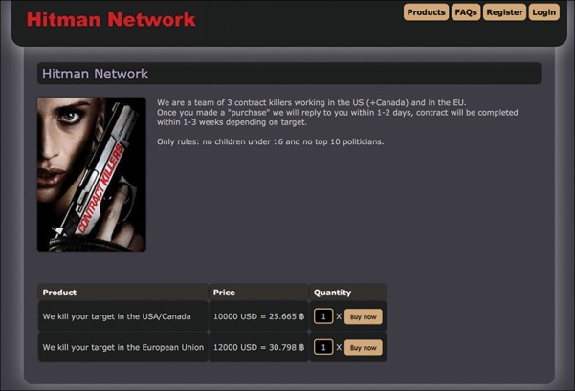

Slide 15
IoT challenges
Growing number of devices obtaining IP capabilities -50 billion IoT devices by the year 2020.
Little regulation around securing IoT devices.
Limited options for security – cant typically install security products or lock down ports.

Slide 16
Am I home?
IP enabled Ring doorbell and Nest thermostat.
Doorbell triggered based on motion leaving the home, and the thermostat changes to an off state when my phone is detected leaving my home’s network range.
Compromising either of these or associated applications could give an attacker access to my internal network

Slide 17
Discussion point two
What then is the role of a forensic investigator and what are the expectations?
What challenges to you foresee as an investigator?
What kind of skills are necessary to be successful?

Slide 18
Crime in the digital age
Digital forensic investigator:
to scope, contain, and remediate the threat as well as understand everything from how the attack happened to its impact to the organization
can investigate web resources and user systems such as phones, computers, or anything in between as long as it contains digital data

Slide 19
Skills to be successful
Solid understanding of how the underlying technology works and how data is arranged
How the tools interprets and displays information
Gather facts and form a hypothesis based on the evidence, consider other possibilities, e.g. examining meta-data for a file type; perform some tests with the file of the type and meta-data

Slide 20
Examples tasks
Cyber extortion investigation:
Determine whether the ransom emails were sent from the suspect computer?
Leak to news media:
Which printer was used to print sensitive documents in an effort to find out who?

Slide 21
Forensic Investigation Case
You are the lead forensics investigator for XYZ, Inc. You have just been notified that a top 5 health care company has hired your company to investigate a potential breach of their medical records system.
The health care company noticed some “inconsistencies” in the Snort IDS logs (Linux) that caused the reliability to be questioned. In addition, the database administrator received a strange e-mail from HR, which contained a benefits attachment. When she opened the attachment, the document was blank. She noticed that her system has been acting “strangely” after opening the attachment. She operates a Microsoft Windows 10 workstation.
Your team has been tasked with analyzing the HCC network, database server, and any workstations you suspect to determine if there was a breach and any potential patient data leakage. The database server is a Microsoft Windows 2003 Server running Microsoft SQL Server 2008.
If there is any evidence of a breach, the health care company has a history of taking these types of incidents to court for prosecution to the full extent of the law.

Slide 22
Goal of a forensic investigation
Collect useful evidence.
Do not interrupt business processes.
Ensure that evidence has a positive impact on outcomes and legal action.
Assist any potential investigation of crimes and persuade adversaries to avoid further actions against the organization.
Offer a procedure that has an acceptable cost

Slide 23
Why outsource?
Your team lacks the necessary time, skills, or technology.
There is a potential conflict of interest.
The situation could lead to an expensive or very risky situation.
You want a resource that has a favorable reputation.
Laws require or prohibit your team from engaging.
You have a budget and a preference to leverage another resource.

